Slide 1
Total Payment Volume Growth

Slide 2
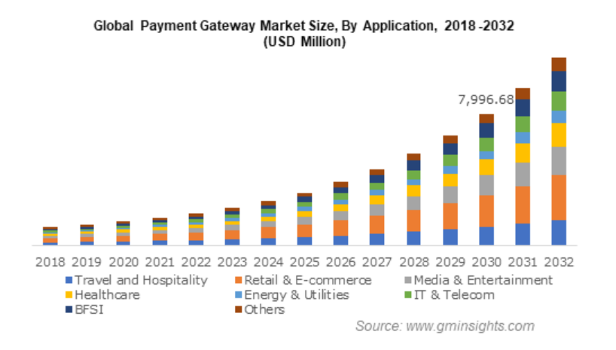
See the Periodic payment volume and trends across it

Slide 3
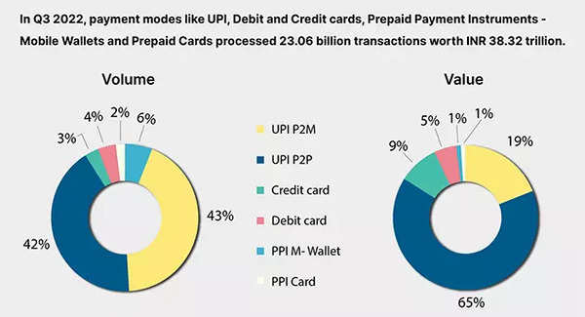
See the Mode wise payment volume and identify the discrepancies in the less volume mode

Slide 4
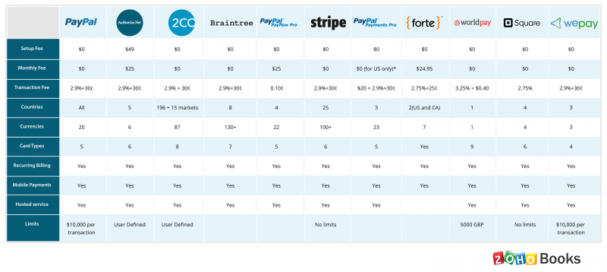
Compare all the aspects of other competitors

